Slide 1
Using “Metacoder” package to visualize microbiome hierarchical taxonomies
Pedro Beschoren da Costa
Postdoc – MICROP – Wageningen University – Entomology Department
Heat tree structure – comparing communities – adding external data
The full content of this workshop is available on https://github.com/PedroBeschoren/metacoder_workshop, including full data and commented code, this presentation, and a HTML file with the full output

Slide 2
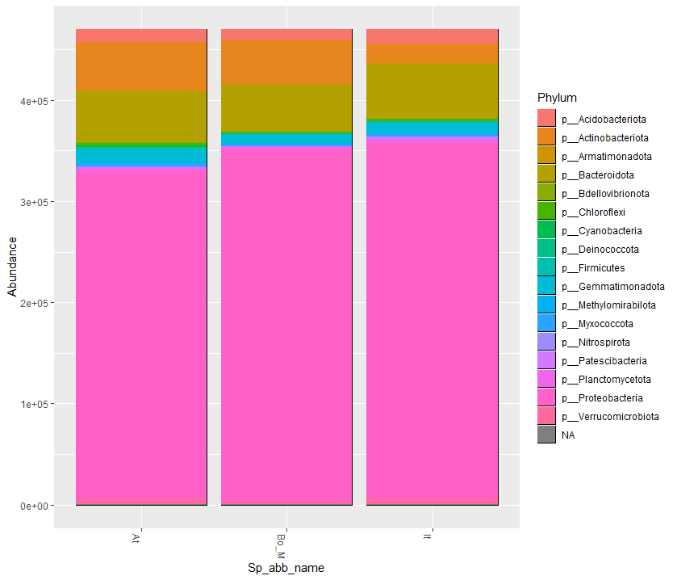
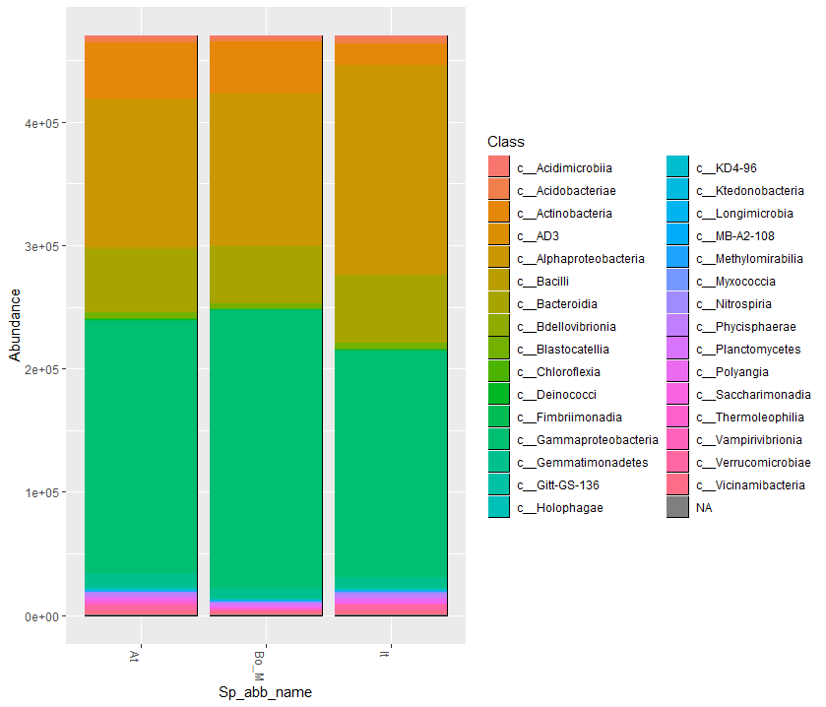
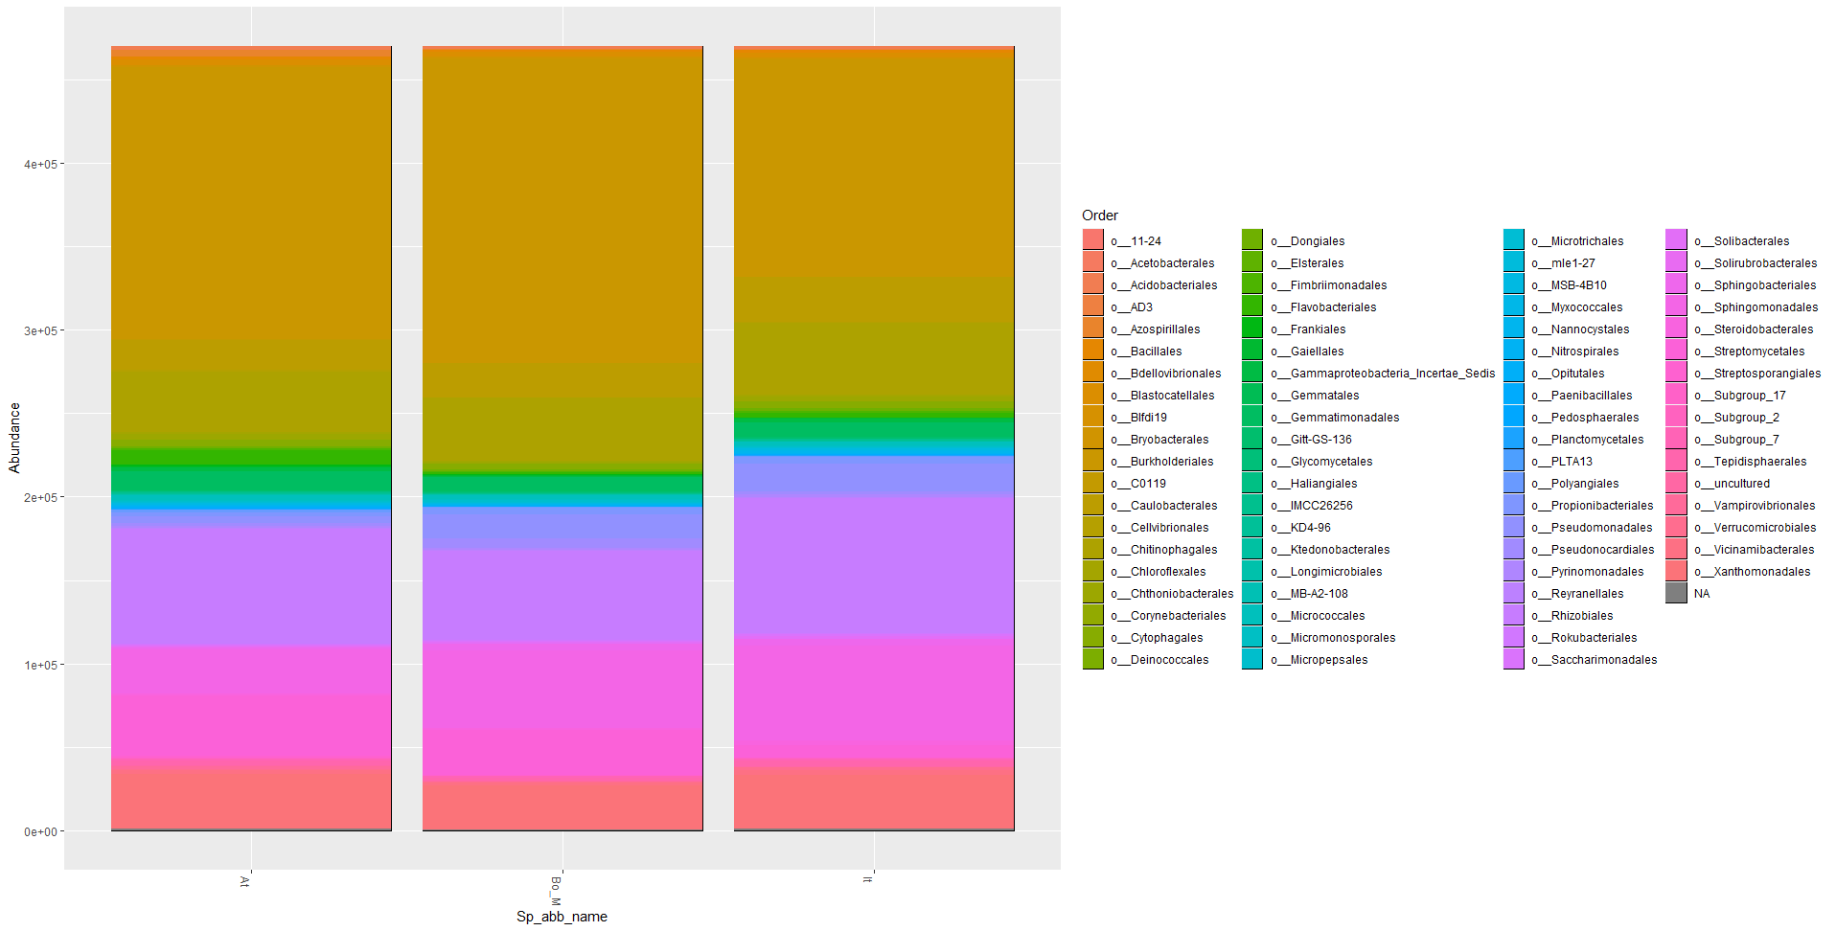
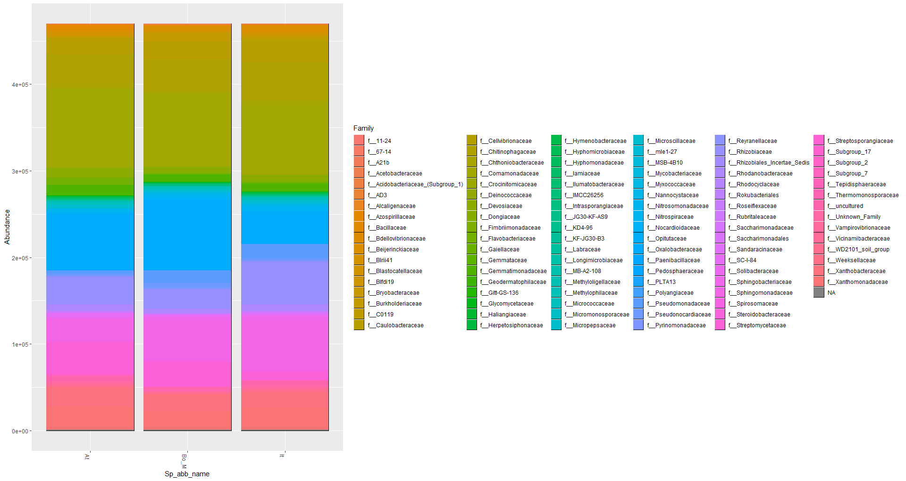
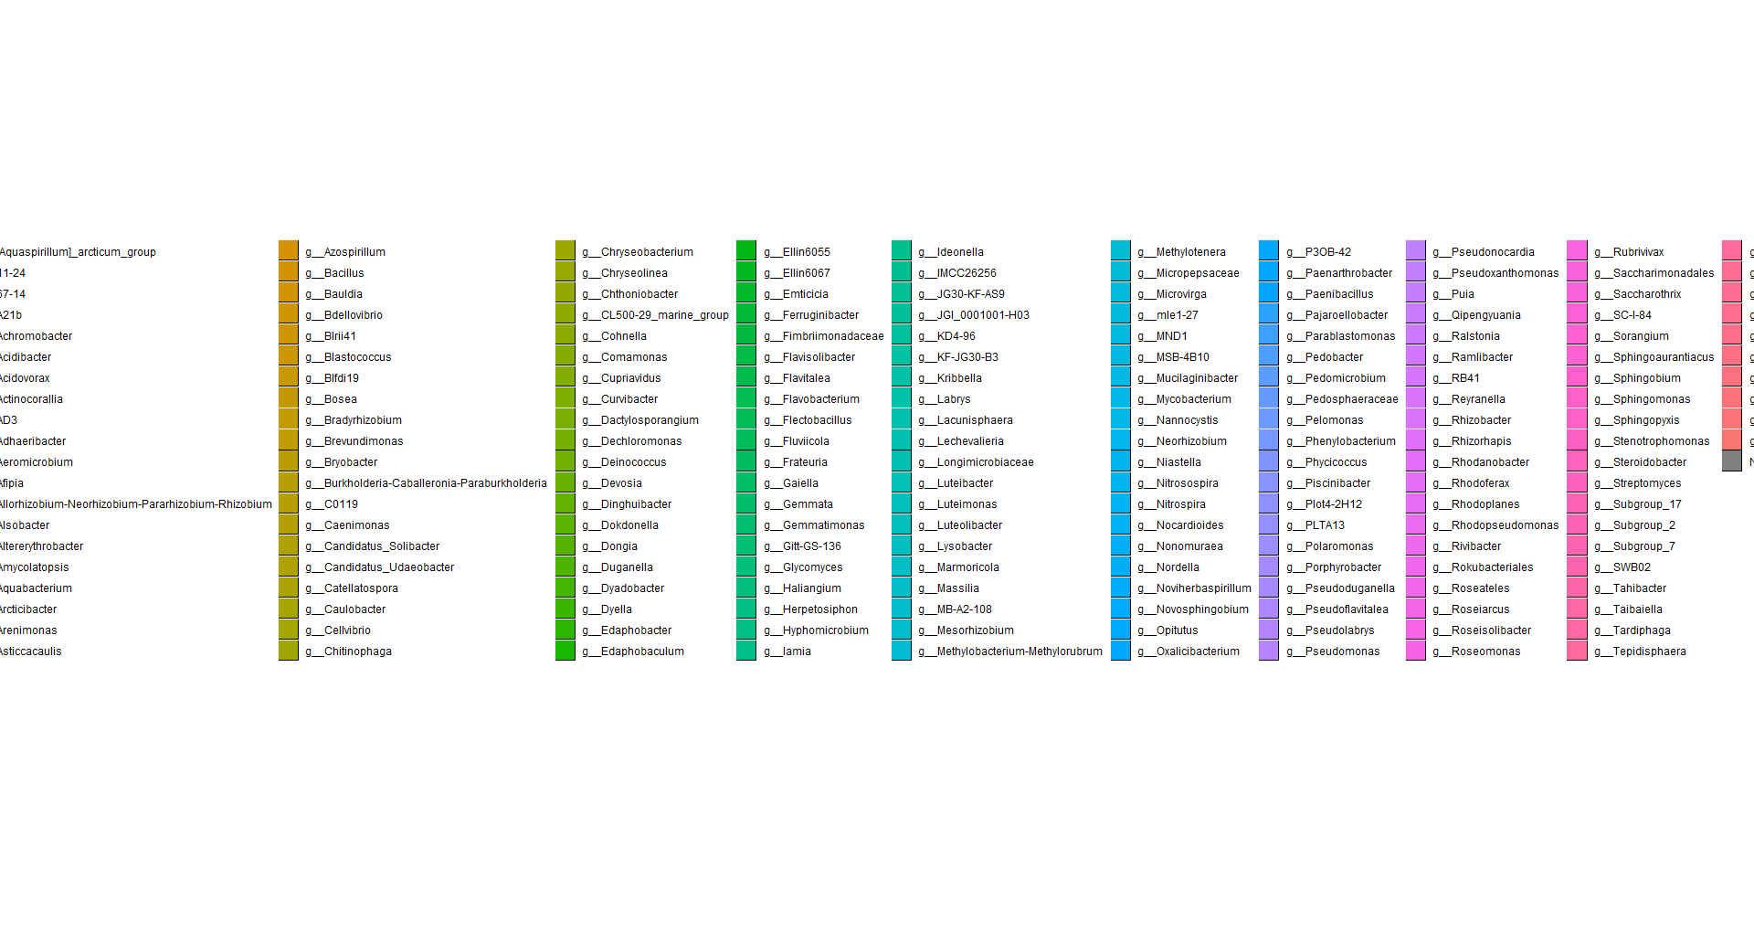
Visualization of taxonomies can be difficult
Classic bar plots have their uses and limitations
Intuitive
Flexible
Fast and easy
Unsuitable for high diversity
Separate plots for each taxa level
Ignores phylogenetical hierarchy
There are many tools to visualize microbial taxonomies – I will show “metacoder”, an R package
Example data is based on a highly filtered version of the Brassiceaceae family experiment

Slide 3
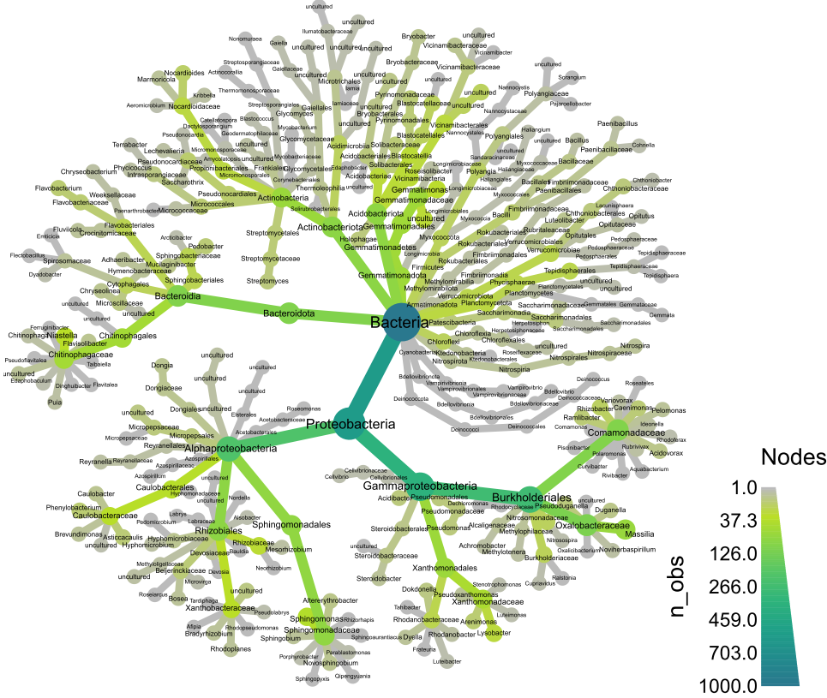
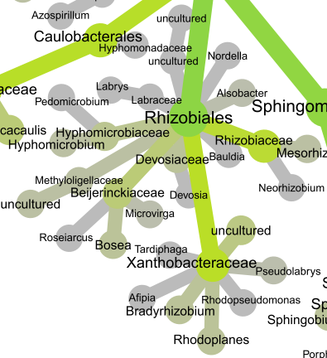
Metacoder is a 2017 data container package for R with a hierarchical taxonomy visualization tool (called Heat Trees)
There are many resources for it
Original paper: https://journals.plos.org/ploscompbiol/article?id=10.1371/journal.pcbi.1005404
GitHub: https://github.com/grunwaldlab/metacoder
Documentation: https://grunwaldlab.github.io/metacoder_documentation/
CRAN manual: https://cran.r-project.org/web/packages/metacoder/metacoder.pdf
Youtube: https://www.youtube.com/watch?v=Nv6dsWjr5sA

Slide 4
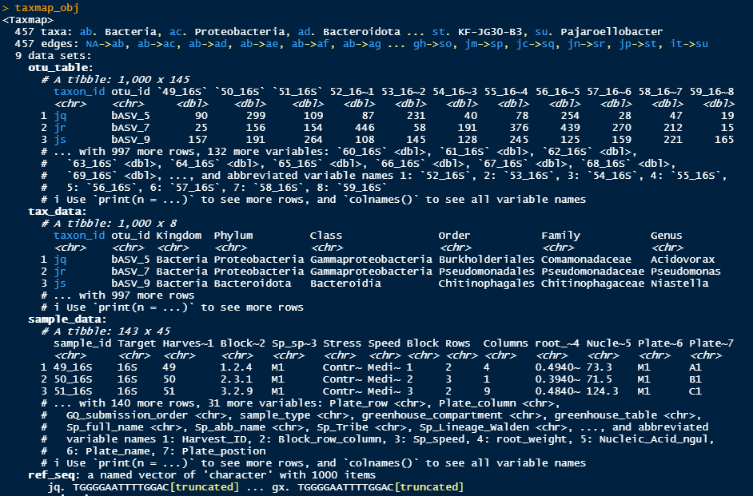
Data layers are contained in a single object, similarly to phyloseq
Note that taxonomies are internally recoded as ab, ac, ad... meaning Bacteria, Proteobactria, Bacteroidota...
The package can handle any hierarchical data, not only microbiome taxonomies.
GO terms could be imported and evaluated, but we won't explore that today

Slide 5
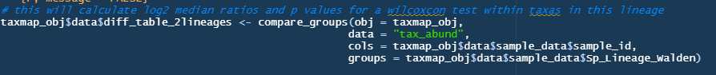
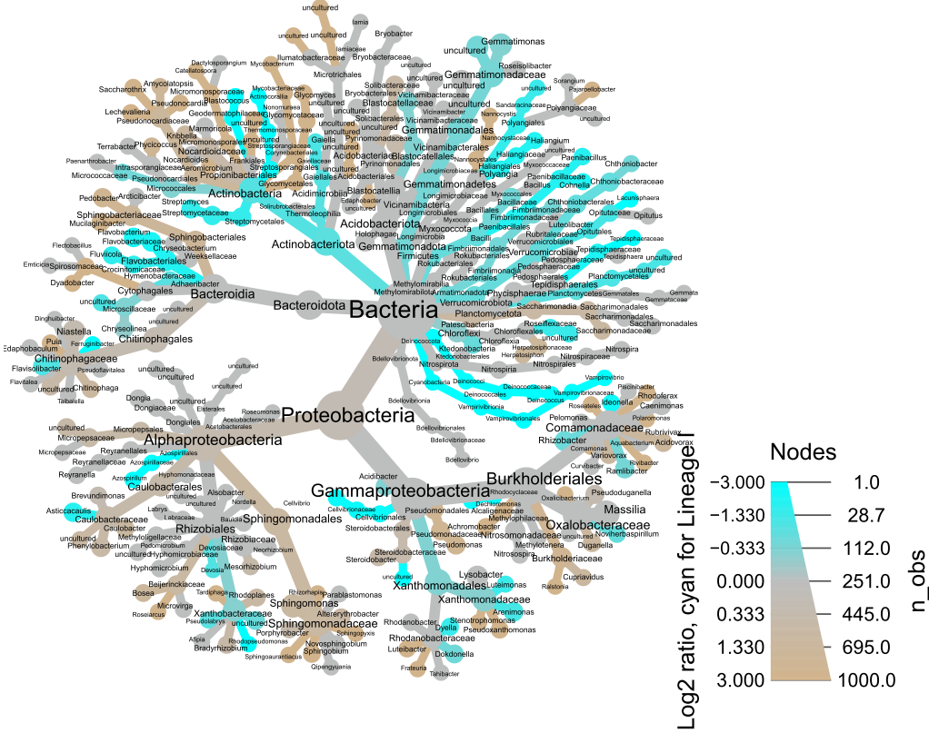
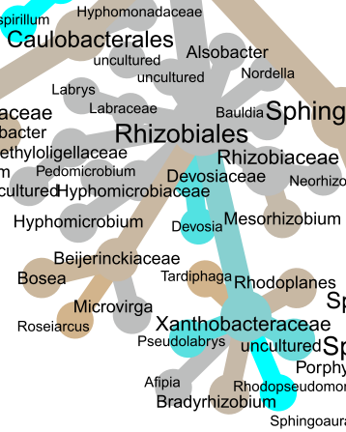
Data analysis and manipulation is also possible
metacoder can also perform operations, like calculation of differential abundance between groups or filtering data
Plotting a value related to an individual taxonomic group, and it's relations to all taxonomic groups, is informative!
For example, here we see different families of Rhizobiales as different between two lineages in brassicaceae

Slide 6
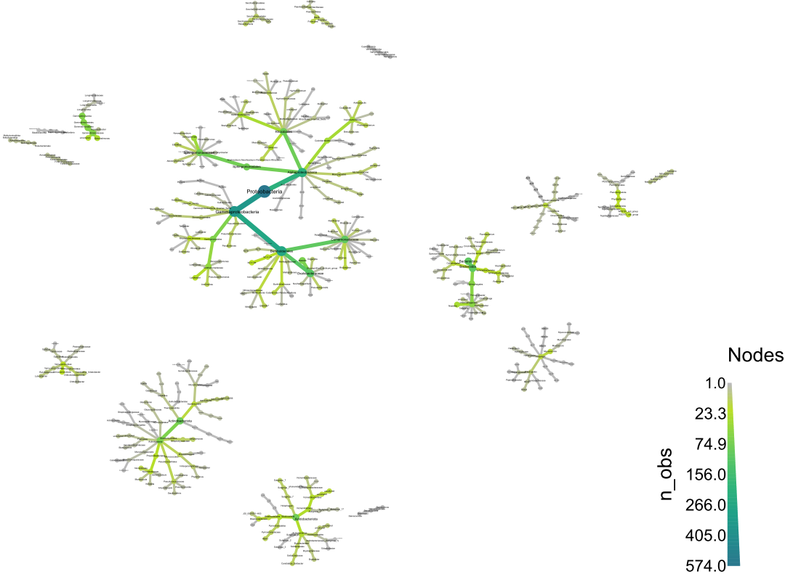
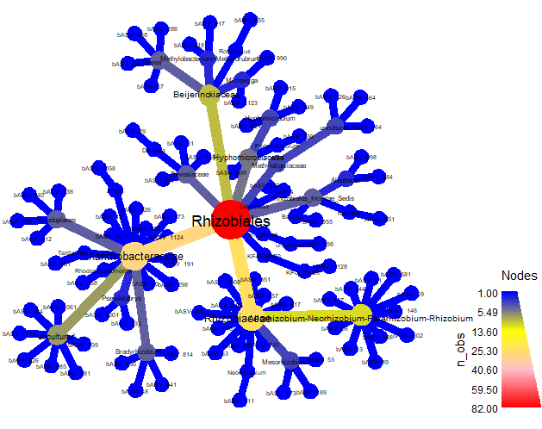
Multiple heat tree options and alternatives available
Split by phylum
See ASVs from a specific group, with different colors

Slide 7
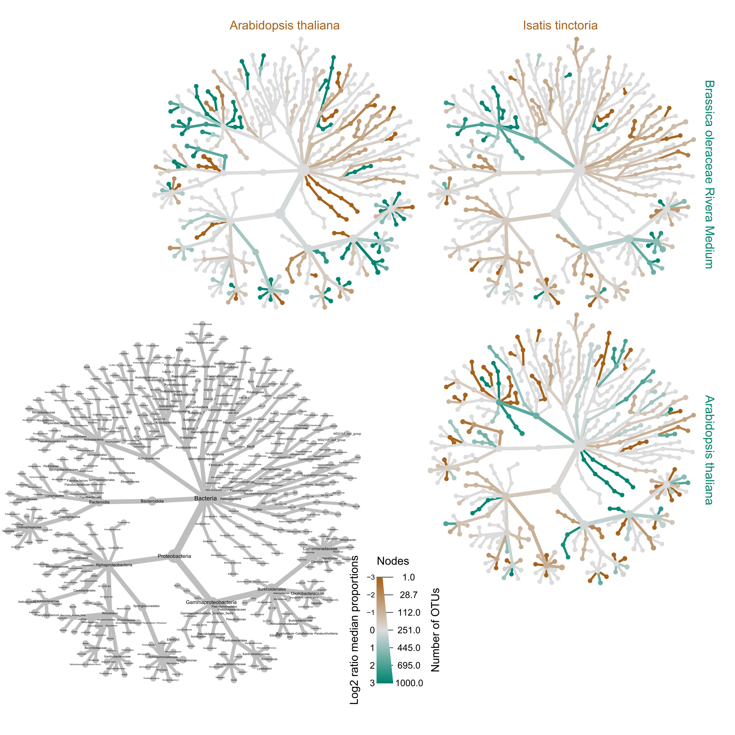
A matrix of heat trees holds a lot of information
You can make multiple pairwise comparisons between treatments
The big grey tree serves as a legend key
The colors on the labels indicate what is the comparison
Isatis Tinctoria VS Brassica olerace
Isatis Tinctoria VS Arabidopsis thaliana
You can also alter the size of the key VS small trees, remove the key, add taxonomies to the small trees, or change the test for differential abundance (we will not do that today)

Slide 8
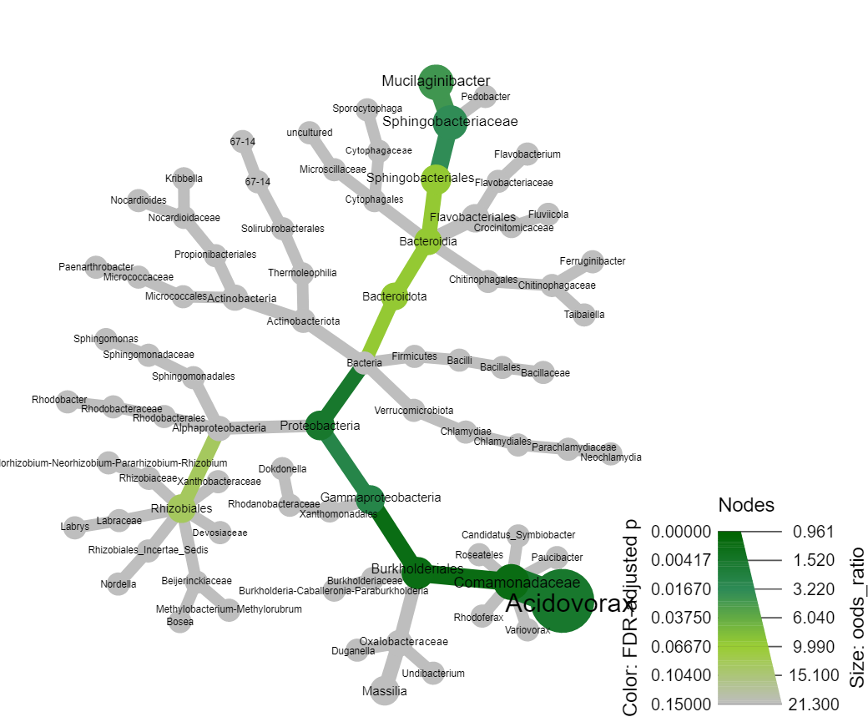
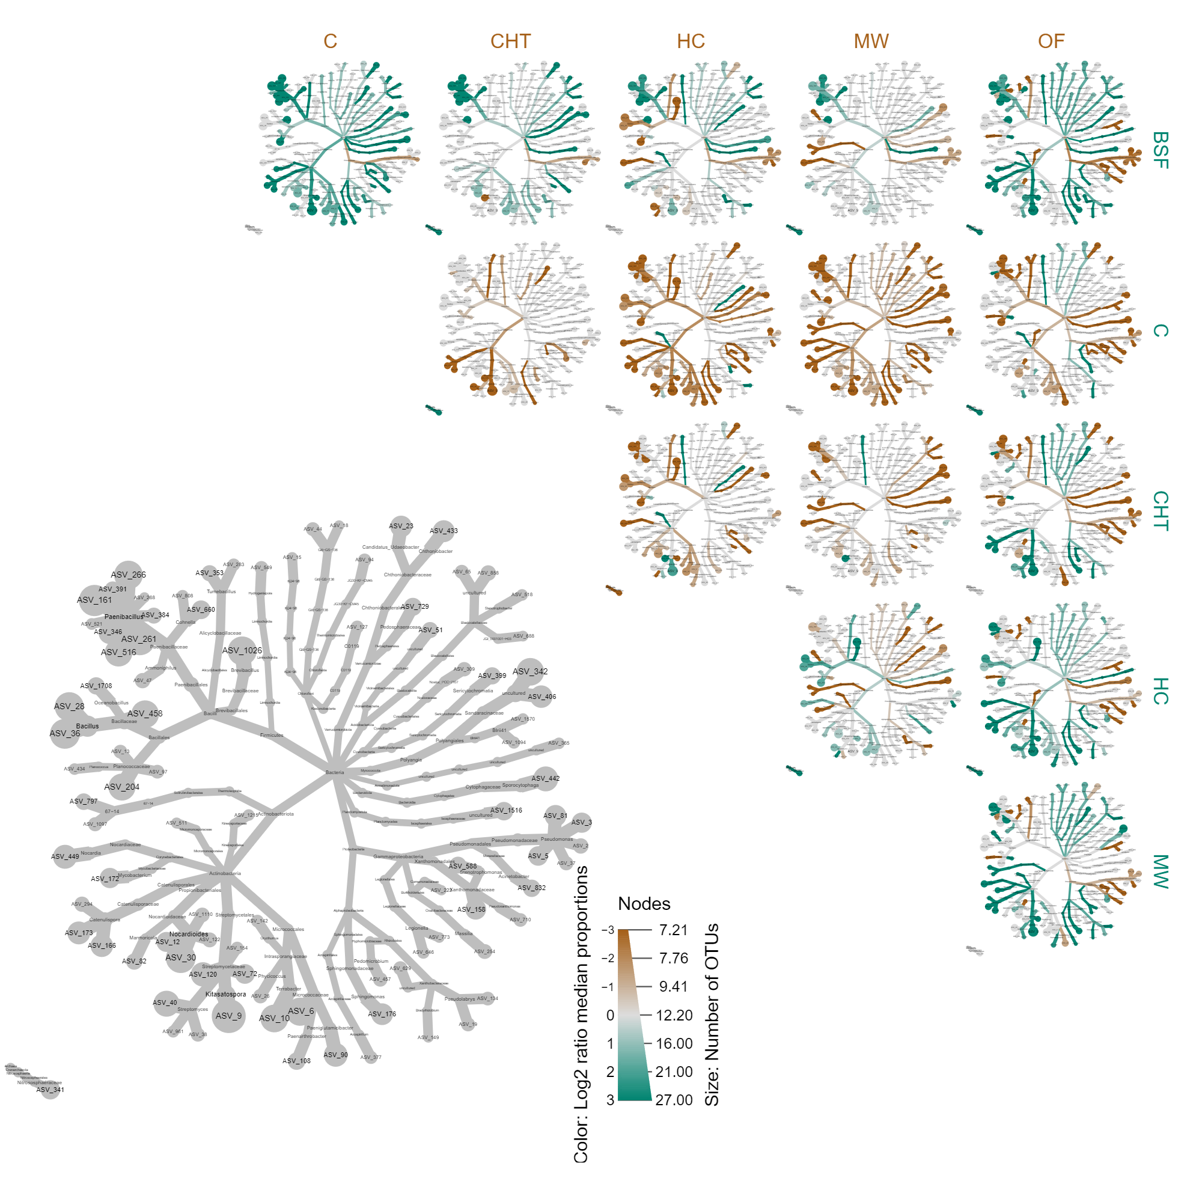
You may add external data from other analysis
Fisher Heat tree
RF importance output
Fisher test p and odds ratio
Useful to compare taxa in a subset of ASVs against the full community
Tells if 8 in 53 is a similar proportion to 57 in 2459
Feature importance on a random forest by Boruta (6 treatments) showing large role of Bacilli ASVs

Slide 9
What we will do today?
If you missed the workshop, the metacoder_workshop.HTML file should suffice as a self-explanatory tutorial
Load phyloseq data into metacoder
Create heat trees
Calculate differential abundances
Compare 2 groups of samples
Compare multiple groups of samples
Create a custom function to streamline the process
Manipulate some variables and create different heat trees
Create lists of matrixes of heat trees
Create mock data and plot it on a heat tree
Add results of a fisher test to the heat tree
How are we going to do it?
Start by opening metacoder_workshop.Rporj with R studio. This will make a new R studio session
Then open metacoder_workshop.HTML with any browser
Then open the metacoder_workshop.Rmd file inside the "code" folder in new R studio session
Run the code chunks one by one – you can make questions at any time, but we will also have breaks for questions

